Slide 1
WCCUSD Early Learning
Program 2021-22 DRDP
Fall Data

Slide 2
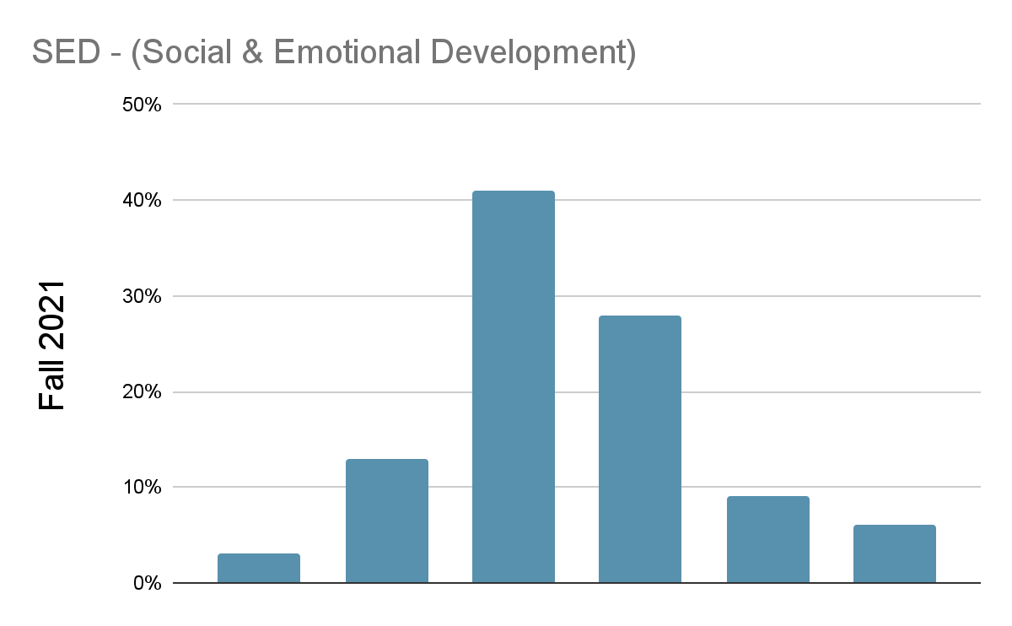
Desired Results Development Developmental Profile (DRDP) Fall Report
Early Learning Program, PRESCHOOL 2021-22
No. of Students Enrolled:
Fall 2021: 229
41%
28%
13%
9%
3 %
6%
Exploring Middle
Exploring Later
Building Earlier
Building Middle
Building Integrating
Later Earlier

Slide 3
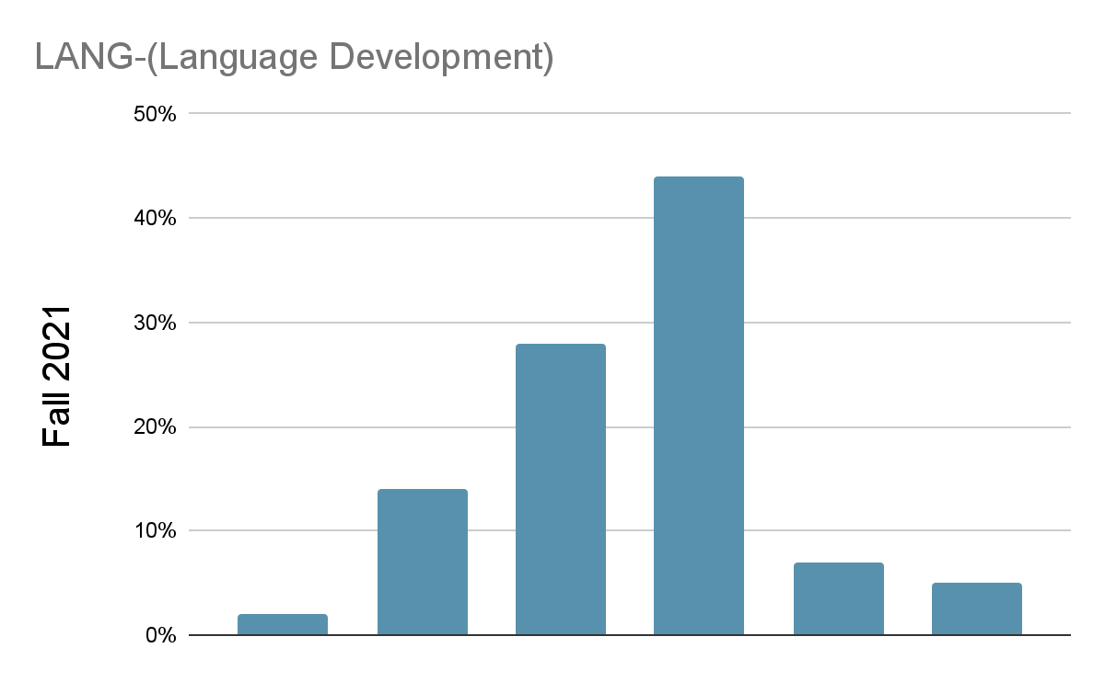
Desired Results Development Developmental Profile (DRDP) Fall Report
Early Learning Program, PRESCHOOL 2021-22
No. of Students Enrolled:
Fall 2021: 229
44%
28%
14%
2%
7%
5%
Exploring Earlier
Exploring Middle
Exploring
Later
Building Earlier
Building Building
Middle Later

Slide 4
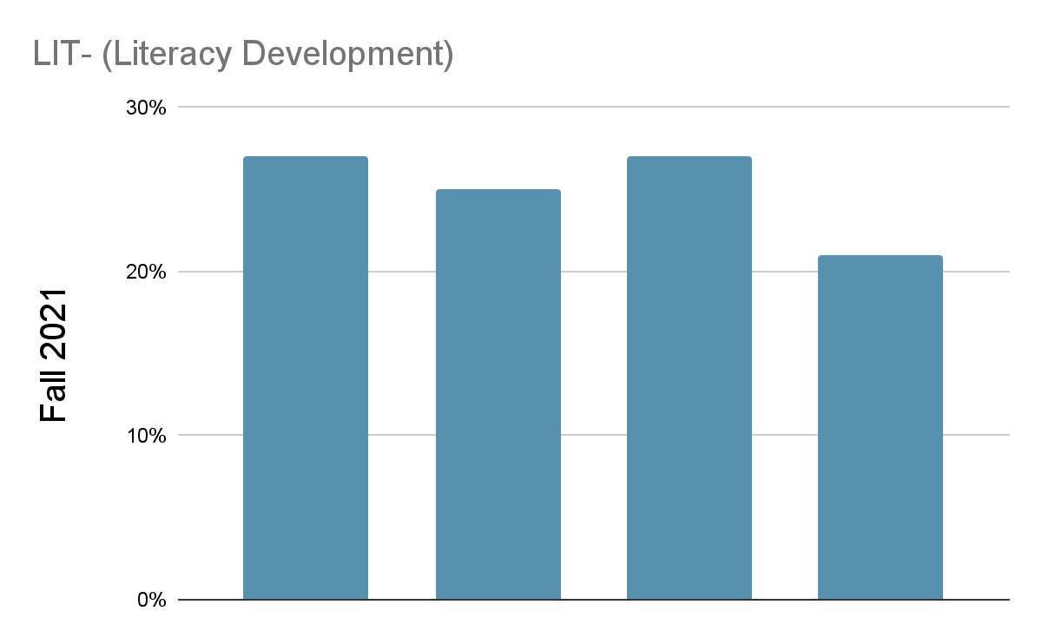
Desired Results Development Developmental Profile (DRDP) Fall Report
Early Learning Program, PRESCHOOL 2021-22
No. of Students Enrolled:
Fall 2021: 229
27%
27%
25%
21%
Exploring Exploring Building Building
Middle Later Earlier Middle

Slide 5
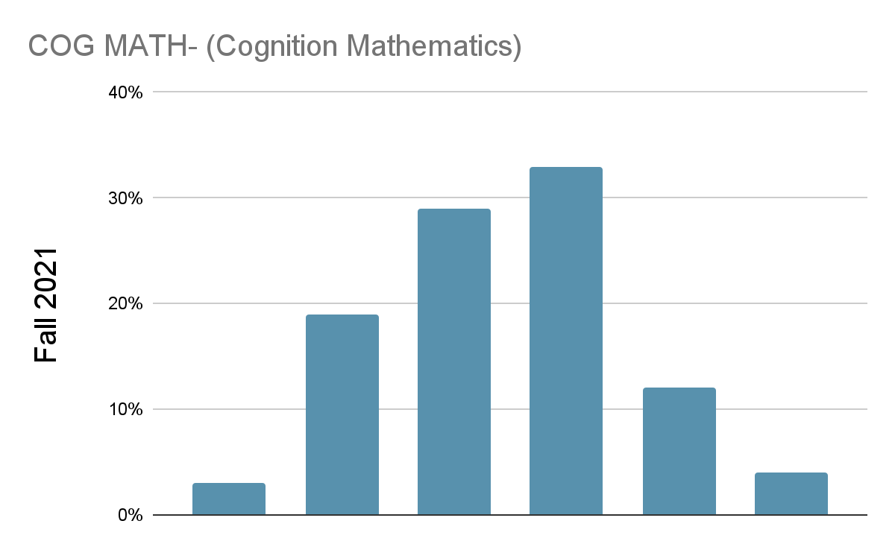
Desired Results Development Developmental Profile (DRDP) Fall Report
Early Learning Program, PRESCHOOL 2021-22
No. of Students Enrolled:
Fall 2021: 229
33%
29%
19%
12%
3%
4%
Exploring Exploring Building Building Building Integrating
Earlier Later Earlier Middle Later Earlier

Slide 6
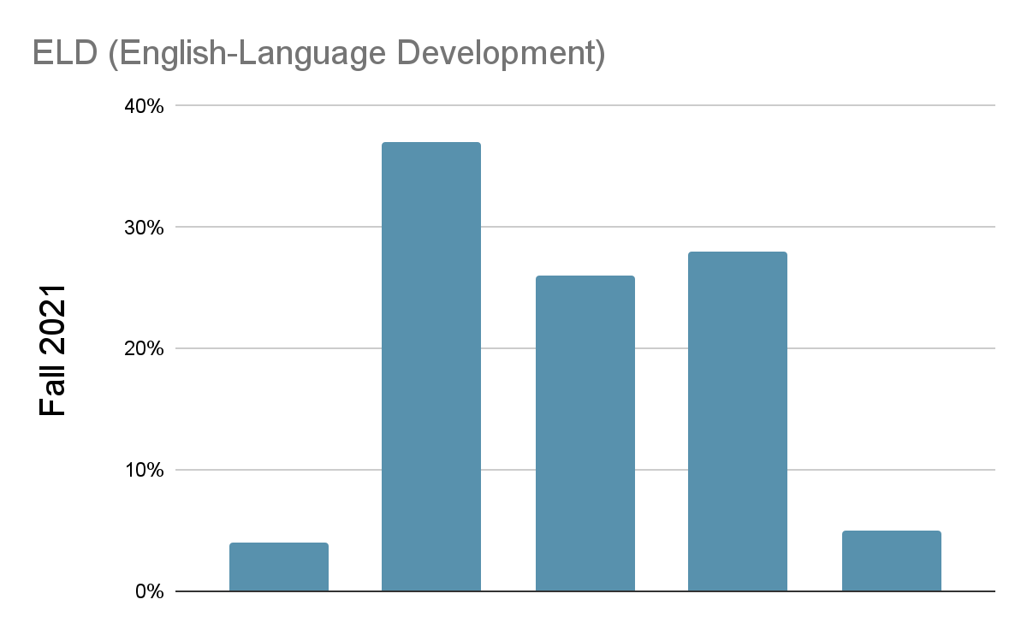
Desired Results Development Developmental Profile (DRDP) Fall Report
Early Learning Program, PRESCHOOL 2021-22
No. of Students Enrolled:
Fall 2021: 229
37%
28%
26%
4%
5%
Discovering Exploring Developing Building Integrating
English English English English English

Slide 7
Group Report
229 children in the 3 yr old Bayview, 3 yr old Dover, 3 yr old Downer, 3 yr old King, 3 yr old Lincoln, 3 yr old Montalvin, 3 yr old Murphy, 3 yr old PM Chavez, 3 yr old Riverside, 3 yr old Washington, 4 yr old AM Chavez, 4 yr old Bayview, 4 yr old Dover, 4 yr old Downer, 4 yr old Ford, 4 yr old King, 4 yr old Lincoln, 4 yr old Montalvin, 4 yr old Murphy, 4 yr old Riverside, 4 yr old Washington class were selected for this report. Not all children may be rated in all rating periods.
Agency Name: West Contra Costa Unified Assessment Period: Fall 2021
Center Name: Bayview State Preschool, Chavez State Preschool, Dover State Preschool, Downer State Preschool, Ford State Preschool, King State Preschool, Lincoln State Preschool, Montalvin State Preschool, Murphy State Preschool, Riverside State Preschool, Washington State Preschool
Class Name: 3 yr old Bayview, 3 yr old Dover, 3 yr old Downer, 3 yr old King, 3 yr old Lincoln, 3 yr old Montalvin, 3 yr old Murphy, 3 yr old PM Chavez, 3 yr old Riverside, 3 yr old Washington, 4 yr old AM Chavez, 4 yr old Bayview, 4 yr old Dover, 4 yr old Downer, 4 yr old Ford, 4 yr old King, 4 yr old Lincoln, 4 yr old Montalvin, 4 yr old Murphy, 4 yr old Riverside, 4 yr old Washington
Subgroup(s):
Rating Period (# of children)
Responding Earlier | Responding Later | Exploring Earlier | Exploring Middle | Exploring Later | Building Earlier | Building Middle | Building Later | Integrating Earlier
Early Infancy
Kindergarten Entry
Approaches to Learning Self-Regulation
The Approaches to Learning skills include attention maintenance, engagement and persistence, and curiosity and initiative. The Self-Regulation skills include self-comforting, self-control of feelings and behavior, imitation, and shared use of space and materials.
Fall 2021
(n=24 )
0% (0) 0% (0)
Social and Emotional Development
13% (3)
46% (11)
38% (9)
3% (1)
0% (0)
0% (0)
The knowledge or skill areas in this domain include identity of self in relation to others, social and emotional understanding, relationships and social interactions with familiar adults, relationships and interactions with peers, and symbolic and sociodramatic play.
Fall 2021
(n=224 )
0% (0) 0% (0)
Language and Literacy Development
3% (7)
13% (29)
41% (91)
28% (63)
9% (21)
6% (13)
The Language and Literacy domains assess the progress of all children in developing foundational language and literacy skills. These skills can be demonstrated in any language and in any mode of communication.
Fall 2021
(n=227)
0% (0)
0% (0)
0% (1)
5% 16% (37)
(12)
43% (98)
24% (55)
7% (17)
5% (7)
Language Development

Slide 8
The Language and Literacy domains assess the progress of all children in developing foundational language and literacy skills. These skills can be demonstrated in any language and in any mode of communication.
Fall 2021
(n=43)
0% (0)
0% (0)
2% (1)
14% (6) 28%
(12)
44% (19)
7% (3)
5% (2)
0% (0)
Literacy Development
Fall 2021
(n=44 )
0% (0)
27% (12)
25% (11)
27% (12)
21% (9)
0% (0)
0% (0)
Cognition: Math
The Math knowledge or skill areas in this domain include spatial relationships, classification, number sense of quantity, number sense of math operations, measurement, patterning, and shapes.
Fall 2021
(n=226)
0% | (0) | 3% | (7) | 19% | (42) | 29% | (66) | 33% | (75) | 12% | (28)
0% (0)
4% (8)
Cognition: Science
The Science knowledge and skills in this domain include cause and effect, inquiry through observation and investigation, documentation and communication of inquiry, and knowledge of the natural world.
Fall 2021
(n=0)
No Score Available
Physical Development — Health
The Physical Development knowledge or skill areas in this domain include perceptual-motor skills and movement concepts, gross locomotor movement skills, gross motor manipulative skills, f ine motor manipulative skills, and active physical play. The Health knowledge or skill areas in this domain include nutrition, safety, and personal care routines (hygiene, feeding, dressing).
Fall 2021
(n=16)
0% (0)
0% (0)
0% (0)
0% (0)
69% (11)
19% (3)
6% (1)
0% (0)
6% (1)
Physical Development
The Physical Development knowledge or skill areas in this domain include perceptualmotor skills and movement concepts, gross locomotor movement skills, gross motor manipulative skills, f ine motor manipulative skills, and active physical play. The Health knowledge or skill areas in this domain include nutrition, safety, and personal care routines (hygiene, feeding, dressing).
Fall 2021
(n=16)
0% (0)
0% (0)
0% (0)
0% (0)
69% (11)
19% (3)
6% (1)
0% (0)
6% (1)
Health
The Health knowledge or skill areas in this domain include nutrition, safety, and personal care routines (hygiene, feeding, dressing).
Fall 2021
(n=16)
0% (0)
0% (0)
0% (0)
69% (11)
19% (3)
6% (1)
0% (0)
6% (1)
History: Social Science
The knowledge or skill areas in this domain include sense of time, sense of place, ecology, conflict negotiation, and responsible conduct.

Slide 9
Fall 2021
(n=0)
No Score Available
Visual Performing Arts
The knowledge or skill areas in this domain include visual art, music, drama, and dance.
Fall 2021
(n=0)
No Score Available
English Language Development
Rating Period
Fall 2021
(n=127)
0% (0)
4% (5)
37% (47)
26% (33)
28% (35)
5% (7)
Discovering Language | Discovering English | Exploring English | Developing English | Building English | Integrating English

Slide 10
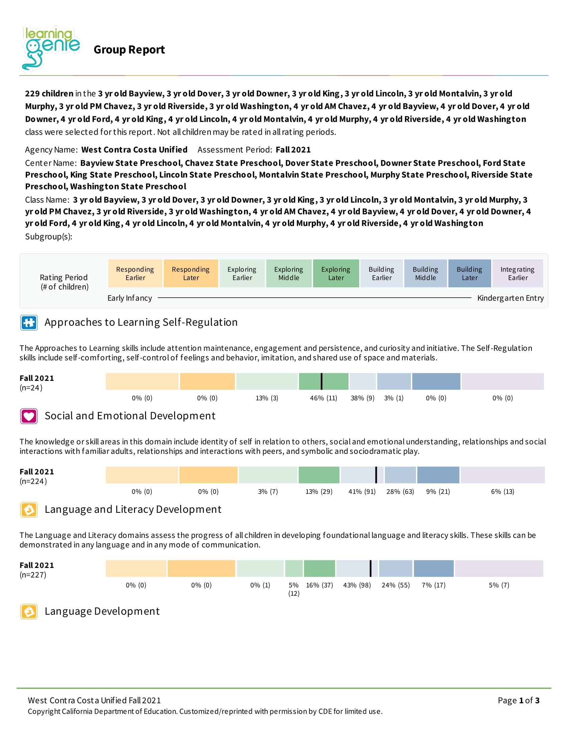

Slide 11
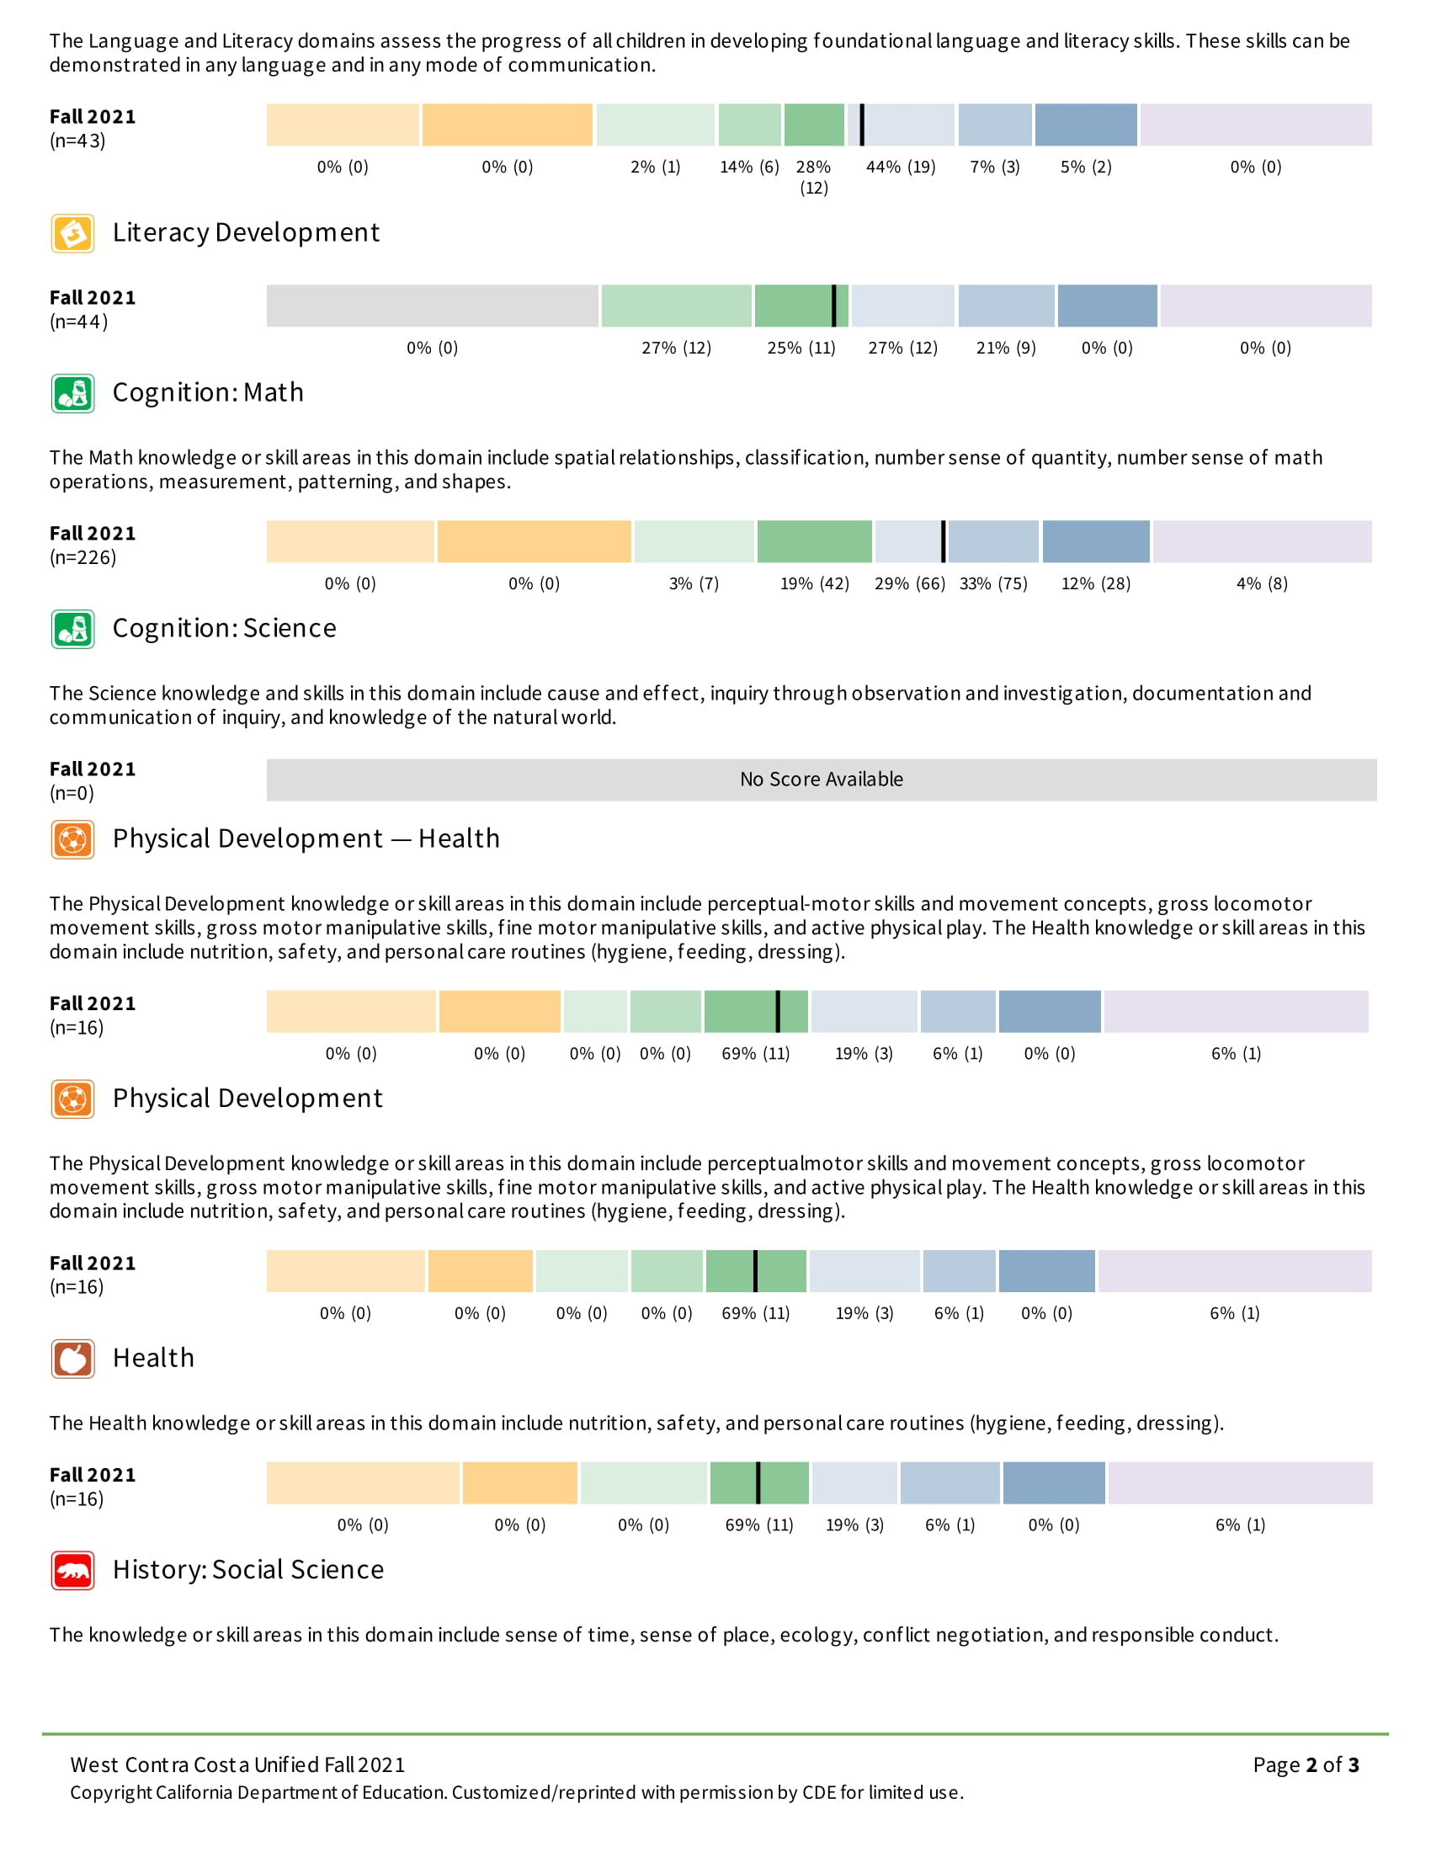

Slide 12
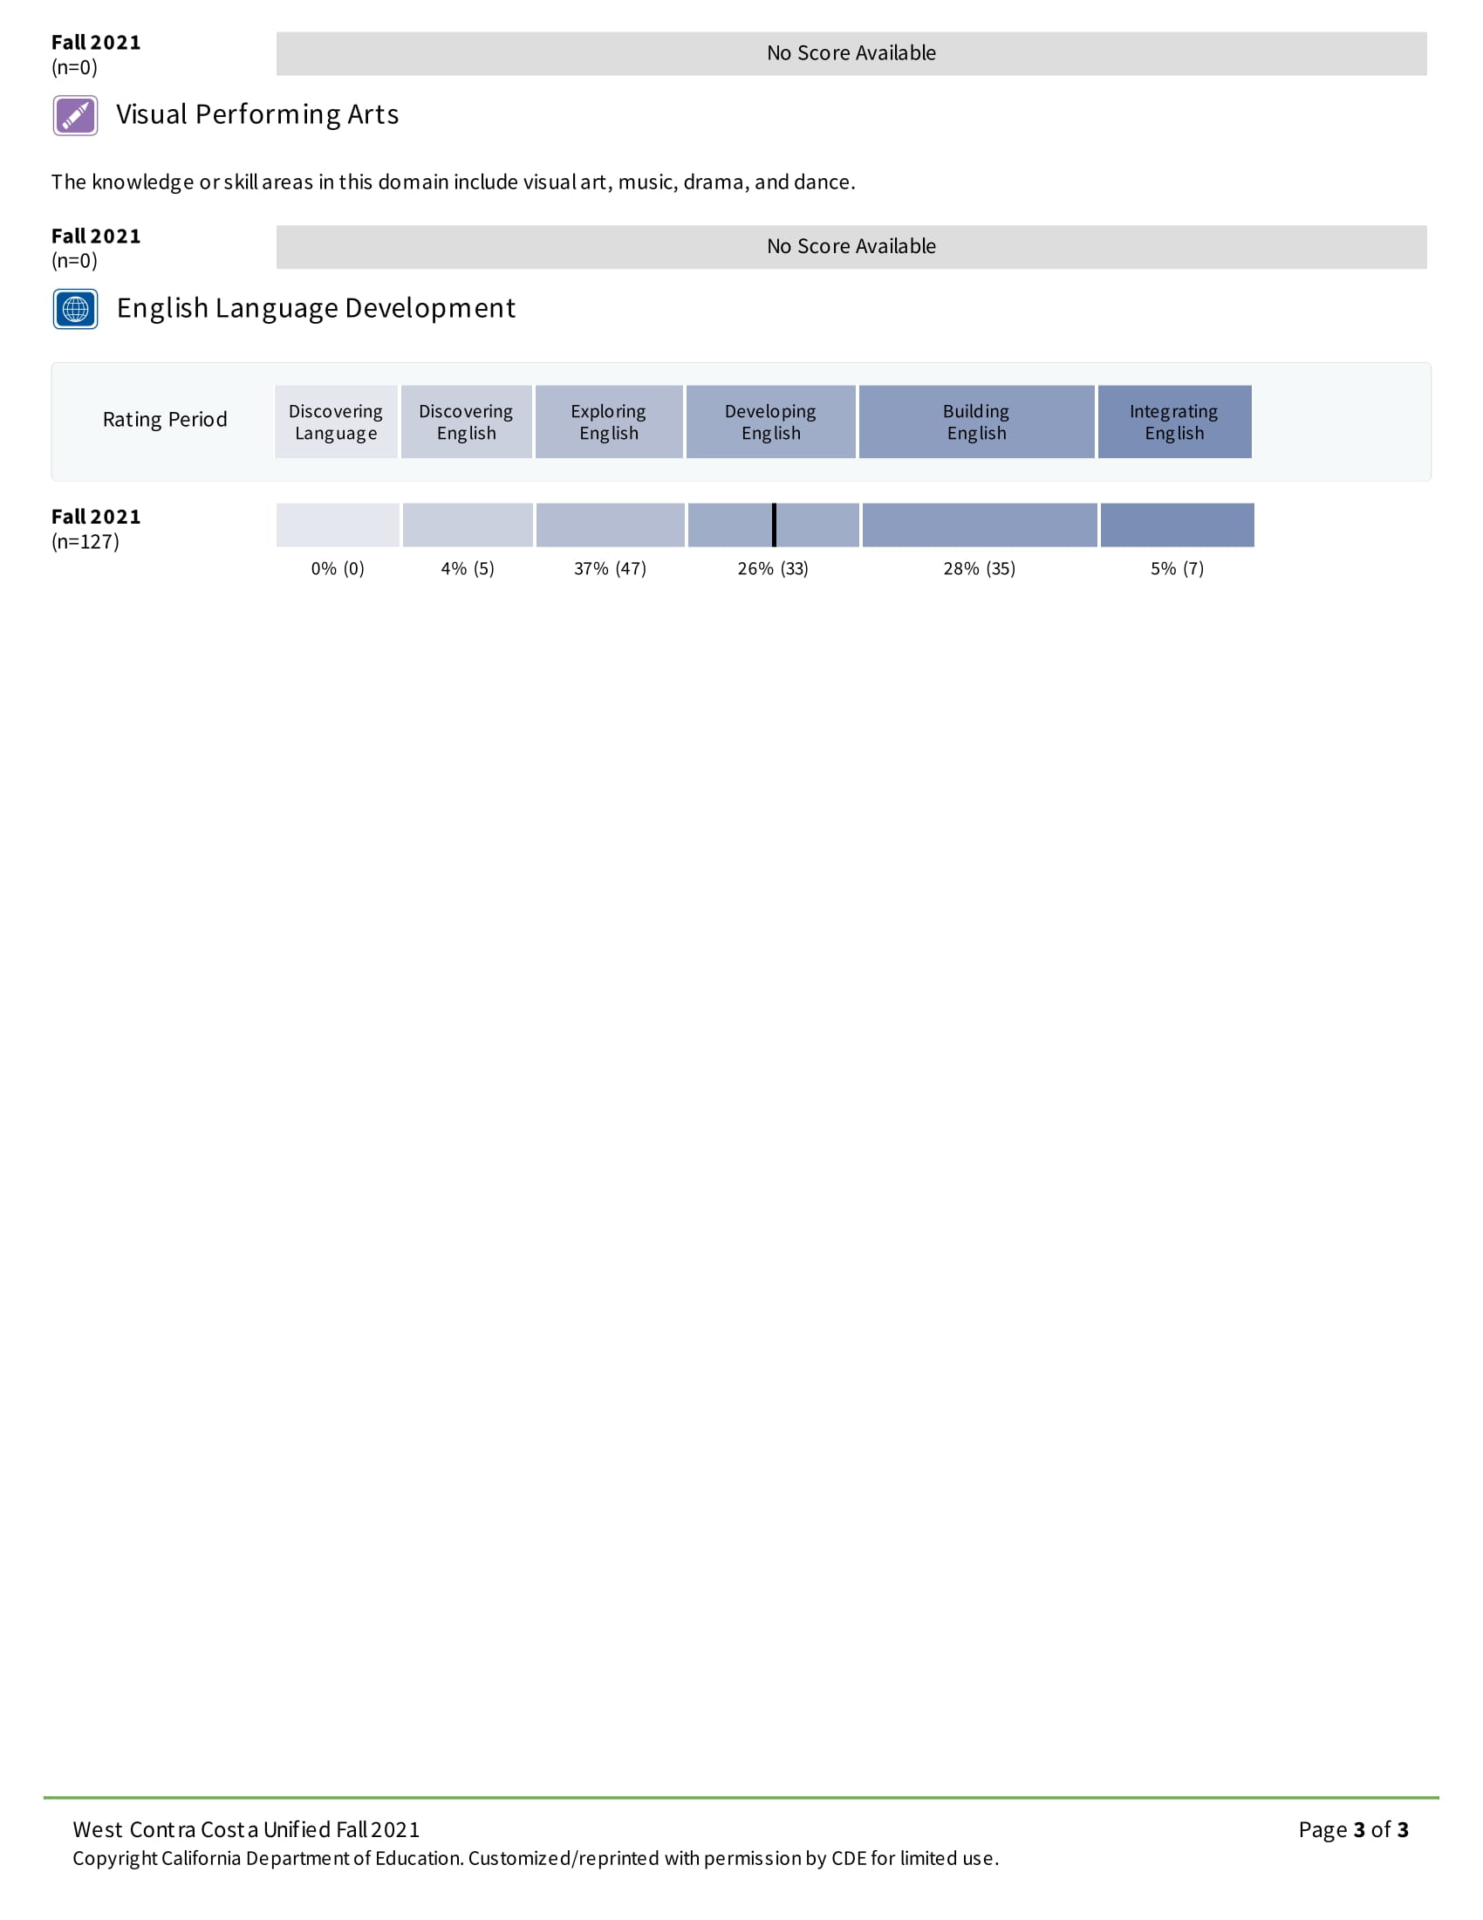

Slide 13
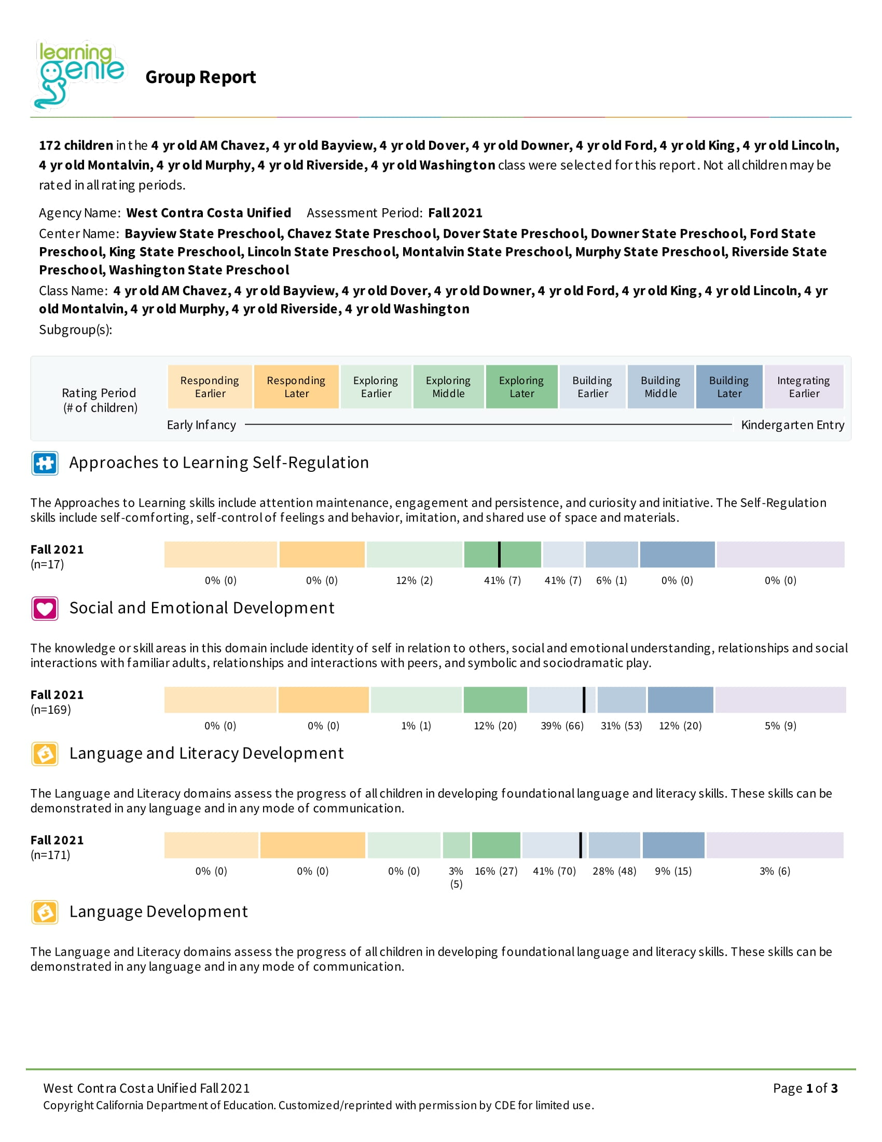

Slide 14
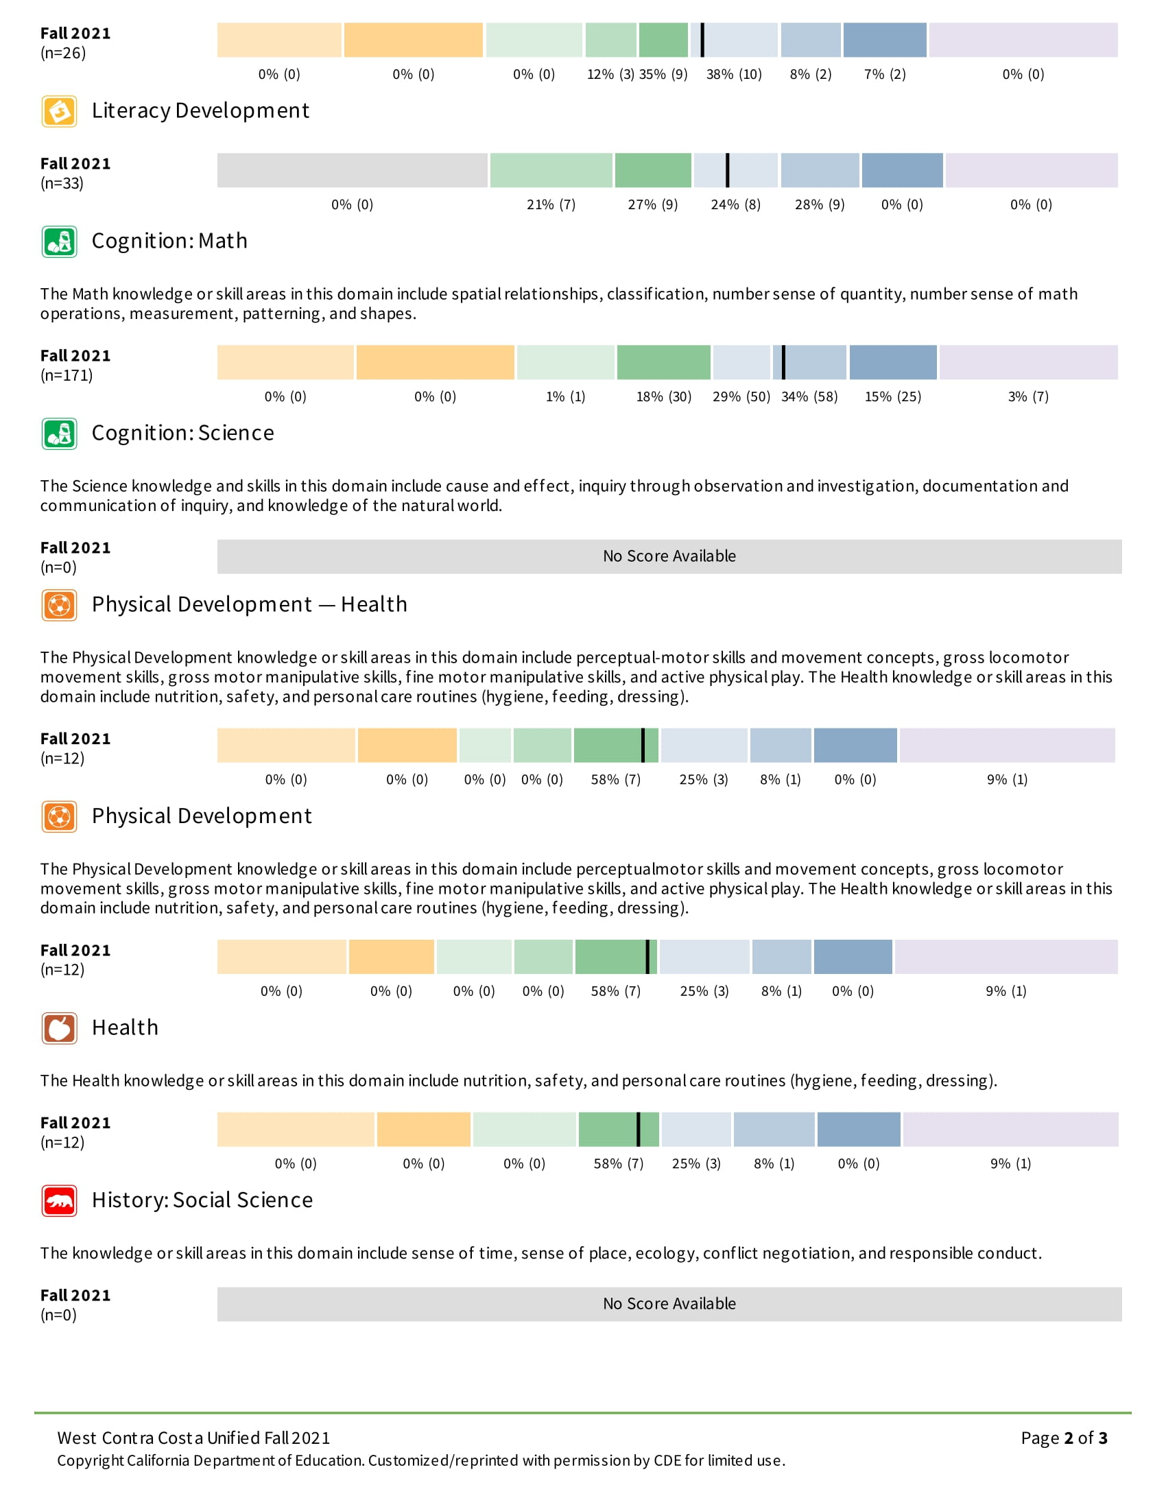

Slide 15
